Slide 1

ECHOLENS
VLMs: Deep learning storytelling from video data(surveillance)
CSE Graduation Project Presentation
Prof. Mohamed Abdelrahman
24/6/2025

Slide 2


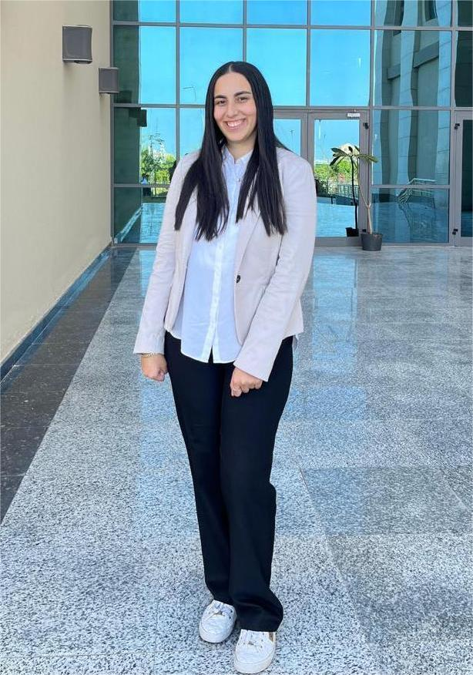


Team Members
Mohamed Elslmawy
George Nashaat
Aya Tamer (Team leader)
Ahmed Dawood
Amr Khaled
AIS
AIS
AIS
AIS
AIS

Slide 3
Outline
Introduction and Motivation
Problem Statement
Literature Review
Proposed Solution
Methodology
Results and Evaluation
Conclusion
Future Work

Slide 4

Why ECHOLENS?
A compelling statistic or fact:
"Over 90% of CCTV footage goes unreviewed due to time
The Problem
Time-Consuming: Reviewing hours of footage is impractical.
Error-Prone: Human fatigue leads to missed critical events.
Costly: Requires large teams for manual monitoring.

Slide 5
Literature Review
Study/Method | Strengths | Weaknesses | Application to Our Work
YOLO (You Only Look Once) | Real-time, accurate object detection. | Struggles with small or occluded objects. | Used for fast, frame-by-frame object detection.
SORT (Simple Online Realtime Tracking) | Efficient tracking with low computational cost. | Struggles with long-term occlusion. | Incorporated for multi-object tracking and ID assignment.
S2VT (Sequence to Video-Text) | Captures sequential data effectively. | Lacks narrative coherence. | Useful for understanding basic captioning.
VideoBERT | Integrates video and text for narrative generation. | Requires significant compute and large datasets. | Informs our CNN-LSTM architecture for sequence processing.
Attention Mechanisms in NLP | Enhances focus on important elements in sequences. | Computationally expensive. | Used to improve interaction analysis and narrative quality.

Slide 6
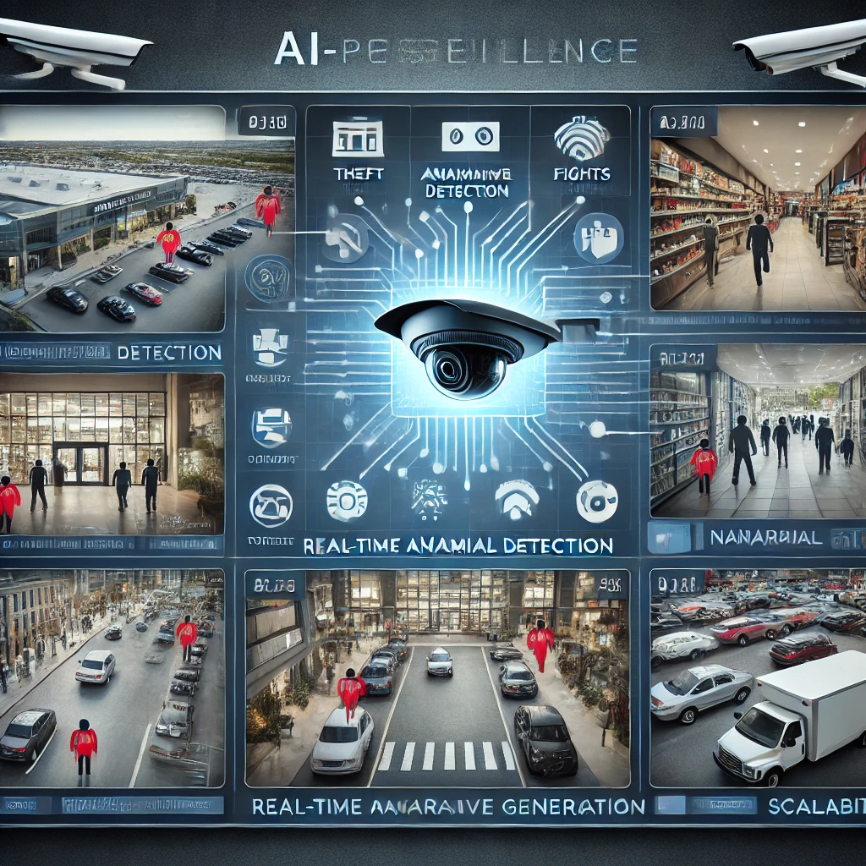
Proposed Solution
Real-Time Detection:
Identifies anomalies like theft and fights instantly.
Narrative Generation:
Converts video data into meaningful, humanlike event descriptions.
Improved Efficiency:
Reduces workload, increases accuracy, and lowers costs.
Scalable:
Applicable across diverse environments like airports, streets, and malls.

Slide 7
Methodology
"This methodology outlines the steps and techniques employed to build the ECHOLENS system for real-time video analysis and narrative generation."

Slide 8
System Overview
Components:
Data Collection and Preprocessing.
Keyframe Extraction
Object Detection and Tracking.
Event Detection.
Narrative Generation.
Model Evaluation.

Slide 9
Data Collection and Preprocessing

Slide 10
Data Collection
-Dataset: "Real-Time Anomaly Detection in CCTV Surveillance.“
Dataset link: https://www.kaggle.com/datasets/webadvisor/real-time-anomaly-detection-in-cctv-surveillance
-Details:
1,900 labeled video clips.
13 anomaly types.
Sourced from diverse surveillance environments.

Slide 11
Data Preprocessing
Category
Normal
Fight
Explosion
Stealing
Road Accident
Vandalism
shoplifting
Arrest
burglary
Shooting
Abuse
robbery
arson
assault
Combined 13 anomaly types into 8 broader categories to reduce model complexity and enhance performance.
Category
Normal
Fight
Explosion
Stealing
Road Accident
Vandalism
Arrest
Shooting
Example: The "Fight" category includes incidents of assault, abuse, and physical altercations.

Slide 12
Data Preprocessing
Dataset balancing :Overrepresented classes were sampled randomly, while underrepresented categories were retained entirely to avoid bias.
Category | Number of Videos Selected | Selection Criteria
Normal | 100 | Random sampling
Fight | 100 | Merged category
Explosion | 100 | Merged category
Stealing | 100 | Merged category
Road Accident | 100 | Random sampling
Vandalism | 50 | All available videos
Arrest | 50 | All available videos
Shooting | 50 | All available videos

Slide 13
Data Enhancement
To improve video data quality, various enhancement techniques were explored, including:
Lighting Adjustment:
Improved visibility in low-light conditions using adaptive brightness techniques.
Noise Reduction:
Removed visual artifacts to improve feature extraction quality.
Padding:
Added borders to maintain consistent aspect ratios across frames, ensuring compatibility with the
CNN-LSTM model.
Resizing Frames (224x224 pixels):
-Standardizes input dimensions to match the neural network's requirements and reduces
computational complexity
Normalization [0,1]:
- Scales pixel values to the range [0,1] to improve model convergence speed and minimize the impact
of brightness and color variations.

Slide 14
Keyframe Extraction

Slide 15
Our proposed Keyframes Selection Models

Slide 16
Model 1-Frame Differencing
Steps:
Detect motion and saves frames as separate images.
Process images individually to extract objects or track motion
Components:
Basic grayscale frame differencing to find motion
YOLOv10x for object detection
SORT for basic object tracking across frames
Limitations:
Requires high computational power and performs poorly on offline or low-resource systems.
Overreacts to irrelevant changes such as lighting, shadows, or wind.
Cannot understand context or intent — it simply detects motion without knowing what it means.
Not adaptable — relies on fixed parameters that don’t adjust to different environments.
Inefficient — produces redundant data and struggles with tracking during occlusion or interruptions.

Slide 17
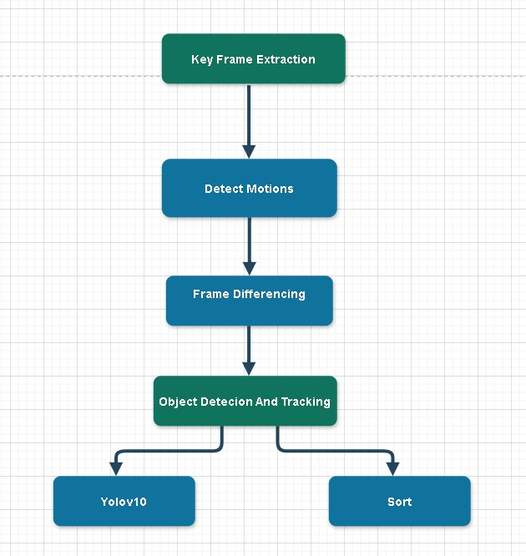
Architecture Of model 1

Slide 18
Keyframes Selection Model 2

Slide 19
Model 2-contextual and raw motion
Steps :
Single-stage video-based pipeline
Combines motion detection, object tracking, and keyframe selection
Operates directly on video — no image saving, high efficiency
Focuses on contextual actions and interactions, not just motion
Components
Motion Detection: Grayscale differencing, color differencing, optical flow
Adaptive Thresholding: Dynamic sensitivity to scene changes
YOLOv12: Fast, high-accuracy object detection
Bot -SORT: Robust object tracking with improved reliability

Slide 20
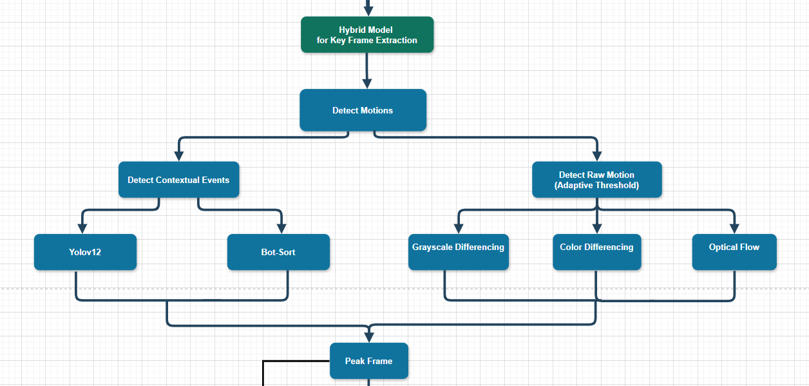
Architecture Of model 2

Slide 21
Model 2-contextual and raw motion
Improvements:
Filters out irrelevant noise and small, unimportant motions
Focuses only on significant, meaningful actions
Adjusts parameters dynamically, making it robust to different scenes
Seamless, faster processing — suitable for live systems(Real time APP)
Saves only the most important keyframes, significantly reducing data size
Maintains tracking even across occlusions or breaks

Slide 22
Keyframe Extraction Comparison :-
Video Name | Total Frames | Model 1 Keyframes | Model 2 Keyframes
Road Accident “RoadAccidents002_x264.mp4” | 347 | 303 | 9
Fighting “Fighting005_x264.mp4” | 1784 | 189 | 32
Stealing “Stealing015_x264.mp4” | 1800 | 540 | 52
Observations:-
Model 1 extracts significantly more keyframes, often capturing redundant frames.
Model 2 achieves greater compression, selecting fewer but likely more distinct or informative frames.

Slide 23
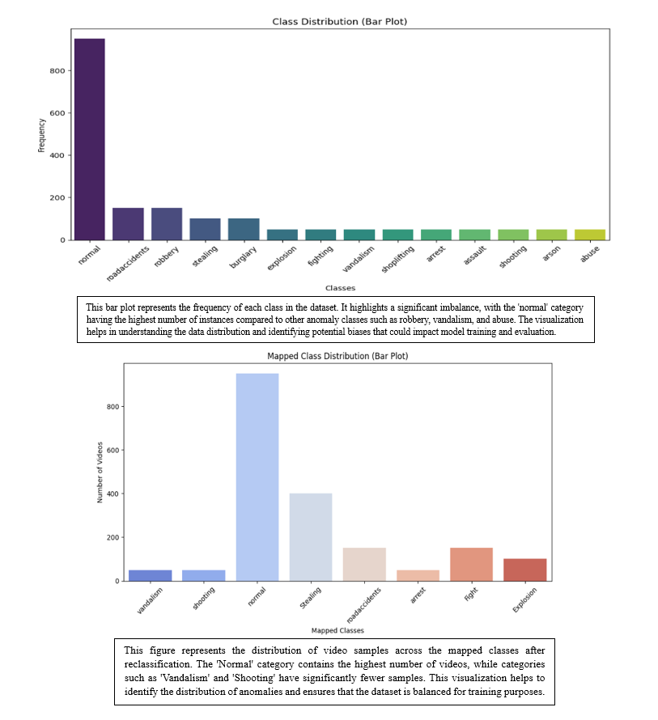
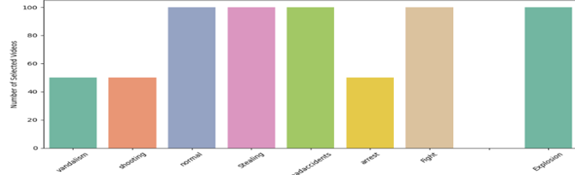
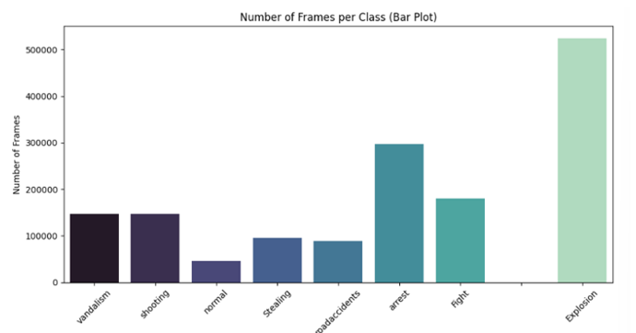
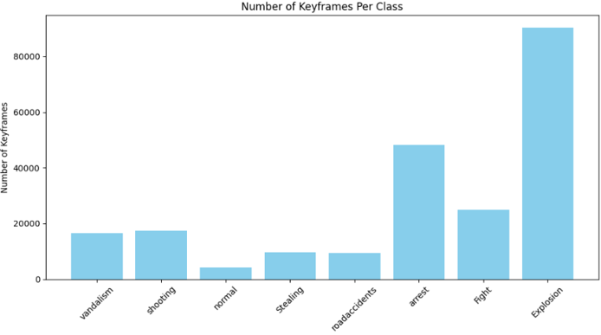
Data
Category | Number of Videos | Selected videos | Number of Frames | Number of Keyframes
Normal | 900 | 100 | 50,000 | 7,995
Fight | 150 | 100 | 180,000 | 7,992
Explosion | 100 | 100 | 520,000 | 10,035
Stealing | 400 | 100 | 100,000 | 7,983
Road Accident | 150 | 100 | 100,000 | 7,915
Vandalism | 50 | 50 | 150,000 | 7,992
Arrest | 100 | 50 | 300,000 | 8,288
Shooting | 50 | 50 | 50,000 | 7,934

Slide 24

Computational Challenges and Infrastructure
Our project involved processing a large-scale video dataset (1,900 labeled clips, 13 anomaly types) using advanced deep learning models (YOLOv12, I3D, Gemini 1.5), which required significant computational power.
We initially subscribed to Google Colab Pro, but it did not meet our performance needs due to memory and runtime limitations.
Since November 2024, we have had continuous access to the university’s high-performance computing resources.
SSH Server Access: The university provided access to a Secure Shell (SSH) server equipped with GPUs, allowing us to:
Remotely train and test deep models.
Handle long video sequences with better efficiency.
Support real-time experimentation and faster pipeline iterations.

Slide 25
Object Detection and Tracking

Slide 26
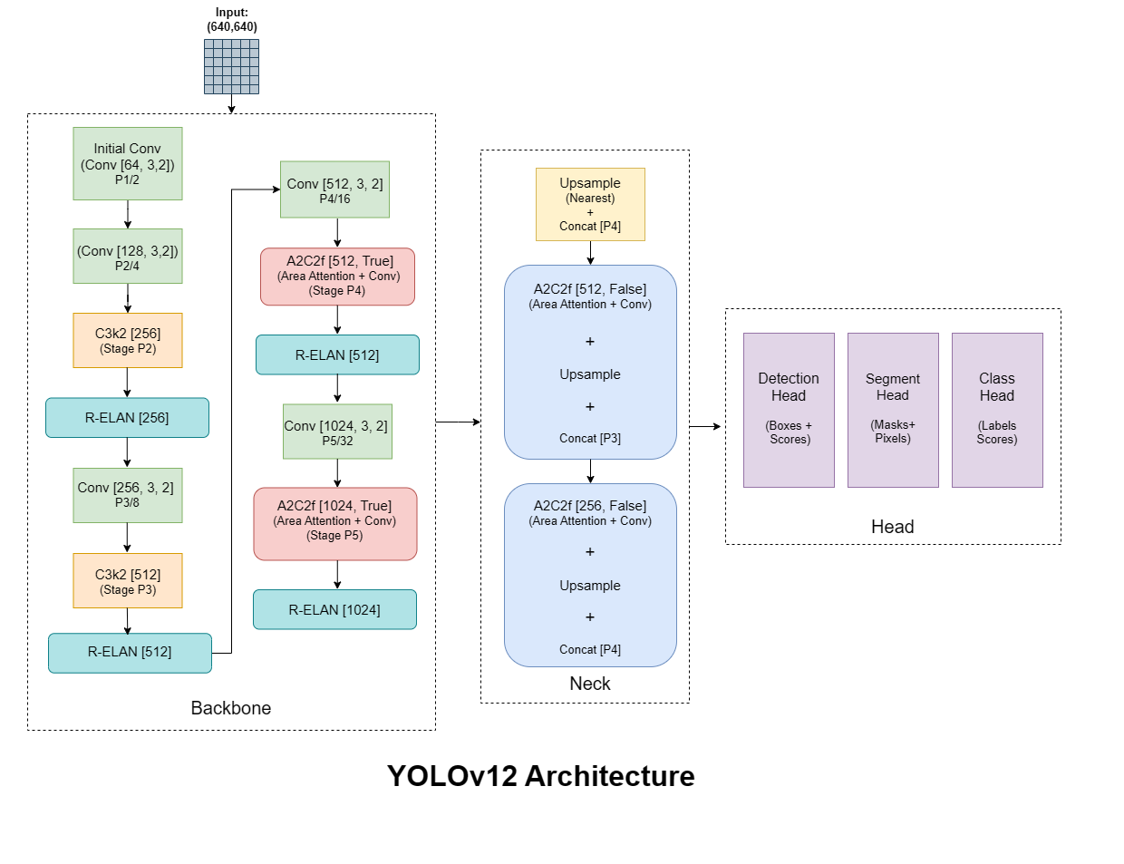
YOLOv12 : Object Detection
Architecture:
Backbone – Feature Extraction
Extracts rich features from the input image at multiple scales
Neck – Feature Aggregation
Helps the model detect both small and large objects by combining low- and high-resolution features
Head – Detection Layer
Predicts: Bounding box coordinates ,Objectless score and Class probabilities
https://arxiv.org/html/2411.00201v4

Slide 27
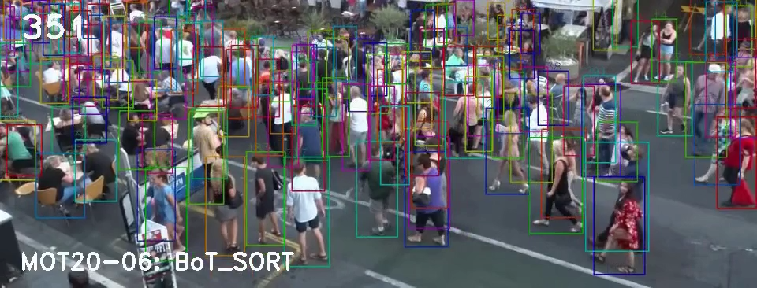
BoT-SORT: Object Tracking
object tracking algorithm that builds on classic SORT and Deep SORT, but with key enhancements for robust multi-object tracking
BoT-SORT uses three key components:
Kalman Filter Predicts the next position of each object based on its previous movement.
IoU Matching Compares how much new and old bounding boxes overlap to match objects across frames.
ReID Features (Appearance Matching) Uses how each object looks (color, shape, etc.) to track it even if it disappears or gets occluded.

Slide 28
Event Detection

Slide 29
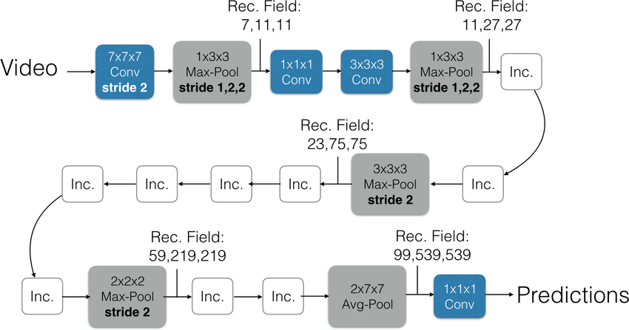
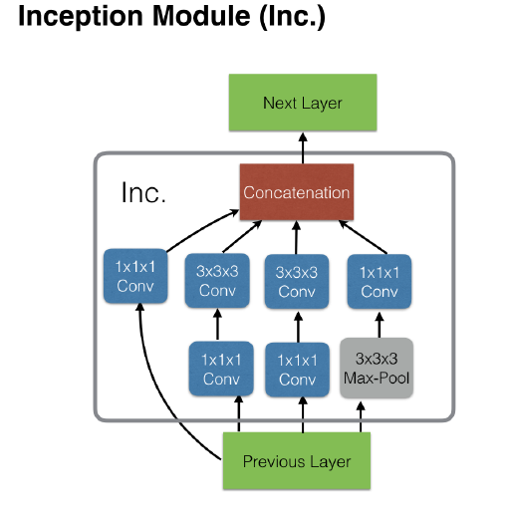
Event Detection using I3D Model

Slide 30
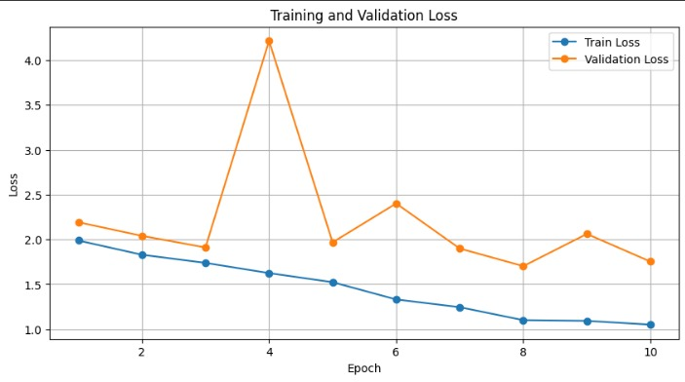
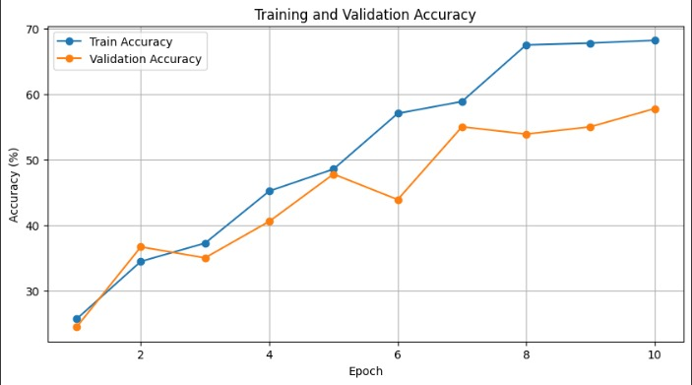
Evaluation model
Loss:
Training loss decreases steadily(from ~2.0 to 0.95)
Validation loss exhibits a spike at epoch 4 and fluctuates afterwards, with a noticeable upward trend after epoch 7
Accuracy:
Training accuracy increases significantly(from 25% to ~69%)
Validation accuracy improves initially (from 27% to ~58%)
Early stopping triggered at epoch 7 to prevent further overfitting

Slide 31
Narrative Generation

Slide 32
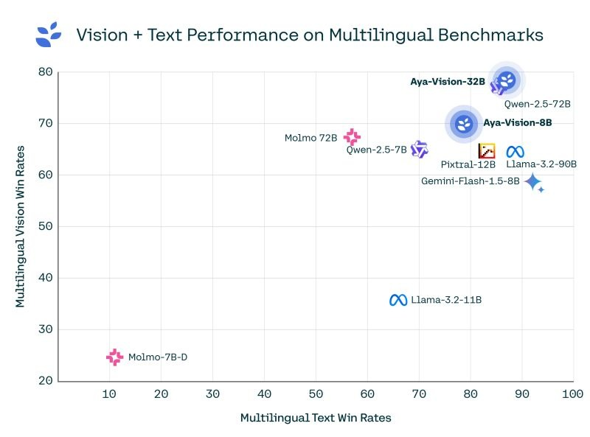
Explore multi-vision language models

Slide 33
Explore multi-vision language models
Model | Key Observations
Video Blip | Video BLIP is an augmented BLIP-2 that can handle videos leveraging BLIP-2 with OPT-2.7b. It does not support multi-modal inputs.
Aya-Vision-32B | Limited to 1 request/minute , Excels in image tasks. Supports 23 languages.
Qwen-2.5-72B | Strong multilingual capabilities. Unstable server,No external content access. Understands as one scene, weaker temporal tracking.
Gemini-Flash-1.5-8B | Performs well in video understanding. can process video frames as coherent sequences. more efficient in generating video-level descriptions compared to others.

Slide 34
Examples of the obtained narrative statements
Video Name | Number of Video Frames | Number of Keyframes Detected | Time Processed | Ground Truth | Story Generated
Road Accidents 002_x264 | 347 | 9 | 35sec | A white bus hit the sidewalk, many cars are driving on the road, many people walking on the sidewalk | A series of surveillance video frames depict a traffic incident in a busy city street where multiple vehicles (a car and a bus) struck pedestrians, resulting in injuries and causing people to scatter. One incident involved a near-miss, while others show vehicles mounting the curb and directly impacting pedestrians.
Fighting 005_x264 | 1784 | 22 | 108sec | A man on the lower left is communicating with others, A white vehicle passed by the door and stopped, Two men in black clothes and masks ran from the door to the right side of the screen, Two men dragged a box out the door, A bald man on the left ran out to stop him, then the box fell to the door and disappeared outside. | Security footage shows a flooded hotel lobby with a truck visible outside. A robbery at the reception desk occurred, followed by a struggle or altercation near the entrance, possibly resulting in one or more individuals fleeing the scene. The hasty departure suggests a connection between the robbery and the subsequent confrontation and escape.
Results from our website

Slide 35
System pipeline
https://drive.google.com/file/d/1bdFVHS-9Scv13FyMtnrfP1dwtrwipxGT/view?usp=drive_link

Slide 36
Conclusion
Achievements:
ECHOLENS leverages Computer Vision & Language models in surveillance applications
Integrating YOLO, Bot-SORT, and fine-tuning I3D model for sequence processing & scalable real-time anomaly detection
Generating structured event descriptions
Improving situational awareness, and aids decision-making
Challenges:
Real-time processing limitations
Accuracy and ethical concerns

Slide 37
Future Work
1. Integrated Multi-Camera System
Deploy a connected network of cameras across locations
2. Real-Time Processing
Enable continuous video streaming and instant anomaly detection
Deliver high-speed analytics with minimal latency
3. Automated Notifications
Instantly send alert messages to the control office
Support proactive response and faster decision-making

Slide 38
References
Academic Papers and Articles :
1. Wang, A., Chen, H., Liu, L., Chen, K., Lin, Z., Han, J., & Ding, G. (2024). "YOLOv10: Real-Time End-to-End Object Detection." Proceedings of the 38th Conference on Neural Information Processing Systems (NeurIPS 2024).
2. Vaswani, A., Shazeer, N., Parmar, N., Uszkoreit, J., Jones, L., Gomez, A. N., Kaiser, Ł., & Polosukhin, I. (2017). "Attention is All You Need."Advances in Neural Information Processing Systems (NeurIPS).
3. Sun, C., Myers, A., Vondrick, C., Murphy, K., & Schmid, C. (2019). "VideoBERT: A Model for Video-Language Understanding." Proceedings of the IEEE/CVF International Conference on Computer Vision (ICCV).
4. Krishna, R., Hata, K., Ren, F., Fei-Fei, L., & Niebles, J. C. (2017). "Dense-Captioning Events in Videos." Proceedings of the IEEE International Conference on Computer Vision (ICCV).
Datasets
Kaggle. (2023). "Real-Time Anomaly Detection in CCTV Surveillance."
URL: https://www.kaggle.com/datasets/webadvisor/real-time-anomaly-detection-in-cctv-surveillance
Tools and Libraries
OpenCV (Open Source Computer Vision Library).
URL: https://opencv.org/
TensorFlow/Keras.
URL: https://www.tensorflow.org/
Ultralytics YOLO. "YOLO Object Detection Framework."
URL: https://github.com/ultralytics/yolov10

Slide 39
Thank
you
Any questions ?

